Slide 1


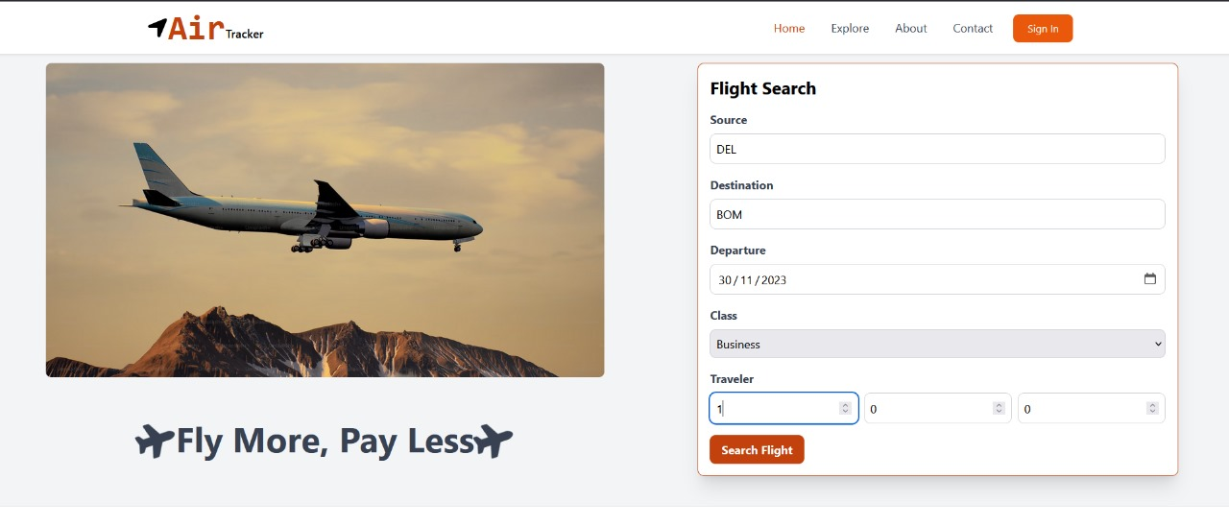
DEPARTMENT OF COMPUTER
ENGINEERING AND APPLICATIONS
Air Tracker : Your Ultimate Flight Companion
Akshat Maheswari
Pankaj Ajmera
Rishit Gupta
Sudhanshu Tripathi

Slide 2

Introduction
1.
Introducing AirTracker, a web application that helps users find affordable flights and track ticket prices. With a combination of cutting-edge technologies and user-friendly design, AirTracker is the go-to platform for all your travel needs.
2.
The motivation behind the project is to provide users with a convenient and efficient way to search for flights and track ticket prices. With the help of AirTracker, users can easily compare prices and find the best deals available. The project is designed to be user-friendly and accessible to everyone

Slide 3

Objectives
1
Affordability
Our main objective is to help users find cheap flights to their desired destinations.
2
Accuracy
We want to ensure that the prices displayed on AirTracker are up-to-date and accurate.
3
Convenience
By allowing users to track ticket prices, we want to make it easier for them to plan their trips in advance.

Slide 4
Problem Statement
The Cost Barrier
Information Overload
Uncertainty
Traveling by air can be prohibitively expensive and many people are unable to take advantage of air travel due to high ticket prices.
With so many different airlines and flight options available, it can be overwhelming and time-consuming to find the best deals.
Prices fluctuate constantly and there is no guarantee that a good deal will be available at a later date.

Slide 5

Literature Review
Expedia
Expedia is a travel platform that provides flight and hotel booking services. It has a user-friendly interface and displays a wide range of flight options.
.
The gap that the AirTracker project is filling is the lack of a convenient and efficient way to search for flights and track ticket prices. With the help of AirTracker, users can easily compare prices and find the best deals available.
The project is designed to be user-friendly and accessible to everyone .

Slide 6
Methodology
1
Data Collection
We gathered airline data and prices from multiple sources and APIs to populate our database.
2
Algorithm Development
We developed a proprietary algorithm to calculate the cheapest flight options based on user input.
3
User Interface Design
We designed a user-friendly interface with a dashboard that allows users to view their tracked flights and receive alerts.
4
Testing and Iteration
We tested our application extensively and made continuous improvements based on user feedback.

Slide 7
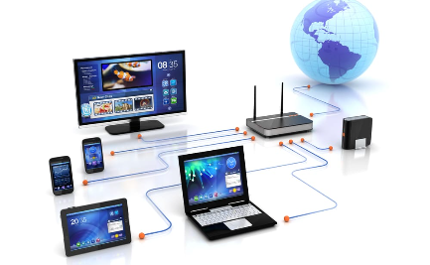
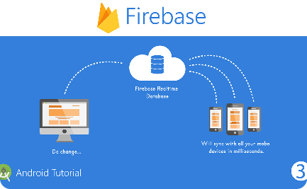
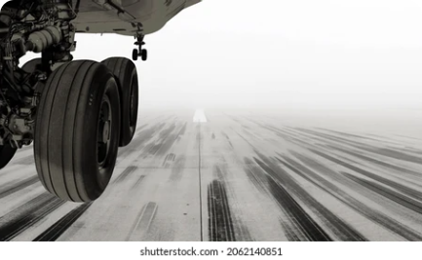
System Architecture
Client-Side
Server-Side
API Integration
React, HTML, and Tailwind-CSS provide a seamless user interface and allow users to interact with the application.
Node.js and Firebase allow for real-time data processing and ensure that users receive up-to-date flight information.
We integrated several APIs, including Skyscanner and FlightStats data, to ensure that our users have access to a wide range of flight options and prices.

Slide 8
Implementation
1
Front-end Design
2
Data Management
3
API Integration
We followed the latest design trends and used Tailwind-CSS to make the interface responsive and visually appealing.
We utilized Firebase to store and retrieve data in real-time with minimal latency and maximum security.
We integrated and tested multiple APIs to gather flight data and ensure accurate pricing.

Slide 9
Features
Price Checking
Filtering Options
Users can check the prices of specific destination and compare with other flights
Users can easily filter search results by airline, price, and other factors.
Price Alerts
Authentication
Users can set price alerts to receive notifications when fares to their chosen destination drop.
Users can register / login via their credentials (Emails , Password)

Slide 10
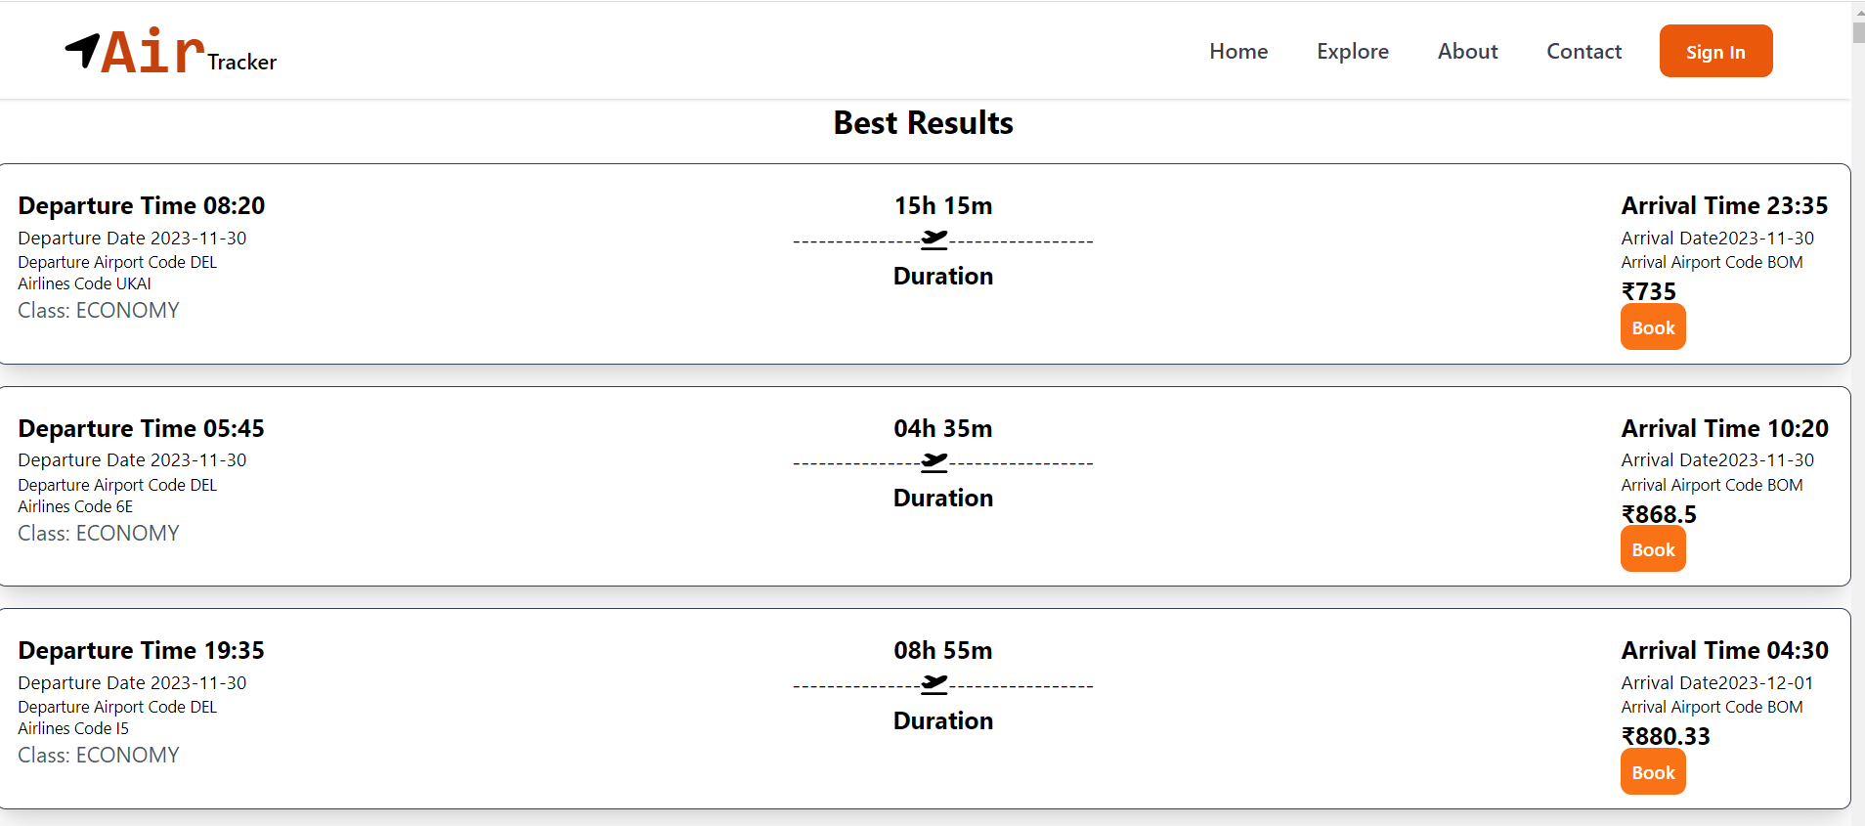
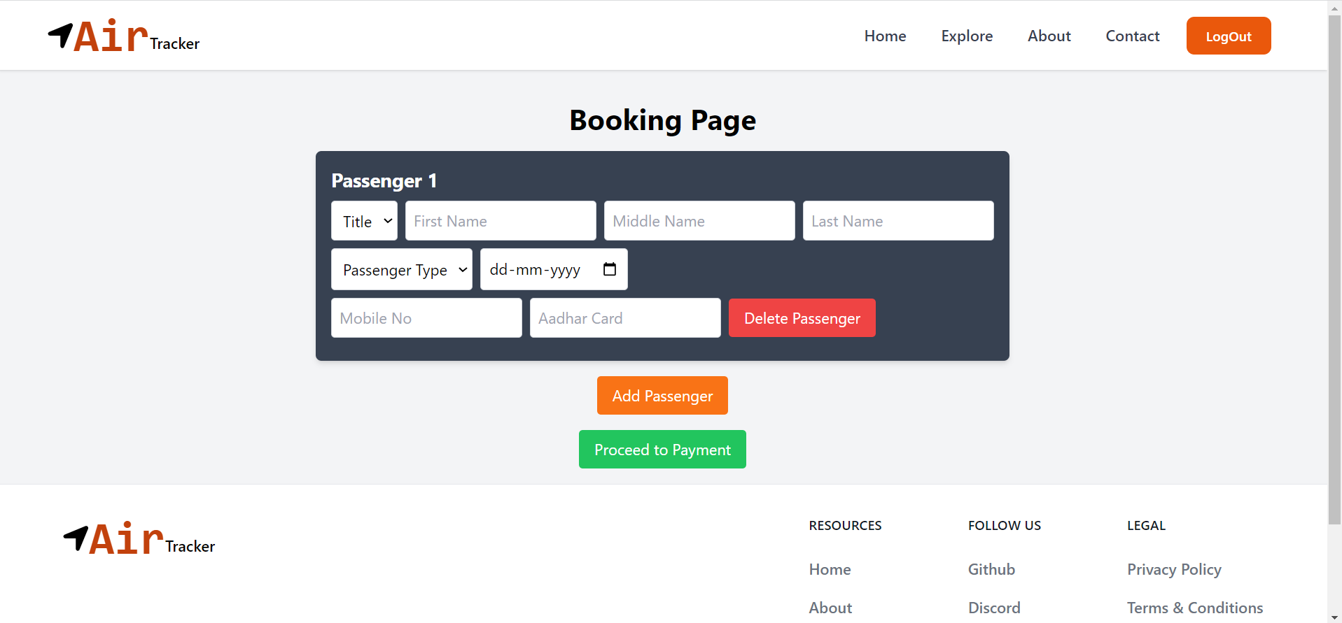
Results
The AirTracker project aims to provide users with a platform to search for the cheapest flights and track ticket prices. The project is designed to be user-friendly and accessible to everyone. With the help of AirTracker, users can easily compare prices and find the best deals available. The application will also provide notifications when prices change, ensuring that users never miss out on a good deal

Slide 11

Challenges Faced
1
Data Integration
2
API
3
User Interface Design
Integrating data from multiple sources and APIs proved to be challenging, but we were able to develop a streamlined process.
Finding free testing APIs and then handling the APIs .
Connecting with the front – end to show results.
Creating a user-friendly interface that was also visually appealing required significant collaboration between our developers and designers.

Slide 12

Future Work
1
Multi-Language Support
We plan to implement multilingual support to expand our user base and cater to a wider market.
Additional Features
2
We aim to add features such as hotel and car rental booking options to further streamline the travel experience for our users.

Slide 13

Conclusion
AirTracker is a revolutionary travel technology platform that redefines the way users discover and book flights. With its cutting-edge algorithms, user-friendly design, and a wide range of features, AirTracker provides a seamless and stress-free travel experience.

Slide 14
Acknowledgments
We would like to express our gratitude to all the individuals and organizations who have contributed to the development of AirTracker. Your support and feedback have been invaluable in shaping the features and functionality of our flight companion app.

Slide 15


Slide 16


